Slide 1
For Loop Practice
A supplemental lesson for AP CSP

Slide 2
Warm-up
During this unit you have:
Worked through algorithms with loops
Created and used a list in a program
Used a for loop with a list
Worked with multiple lists in a program
Traversed a list using a for loop
Reflect on the programs you created and/or modified during this unit.

Slide 3
Introduction
During the first Lists lesson, you learned about a for loop.
Several of your programs from Missions 3-7 use a while loop.
Could they use a for loop instead?
Let’s revisit a few programs and make some more modifications.
Use the sandbox for this lesson.

Slide 4
For Loop Practice: Example #1
Open the LineSense program from Mission 5
Use the sandbox.
In the last lesson, you added the light_show() function, which uses a for loop.
Look through the rest of the code.
Is there another function that currently uses a while loop that could be changed to a for loop?

Slide 5
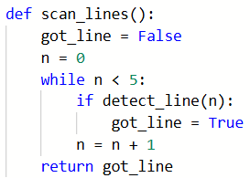
For Loop Practice: Example #1
The LineSense program
You probably identified the scan_lines() function.
Change the while loop to a for loop.
Then run the code to make sure it is error-free.

Slide 6
For Loop Practice: Example #2
Open the final WhatIf program from Mission 3
Use the sandbox.
You created this program a while ago, before you learned about loops.
In the main program, you wrote code that draws a square turning right and a square turning left.
The if statements have a lot of repetition in them.

Slide 7
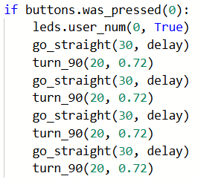
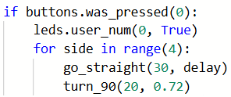
For Loop Practice: Example #2
The WhatIf program
Improve the code by using a for loop for each square.
before
after

Slide 8
For Loop Practice: Example #2
The WhatIf program
Add a for loop to the code for the other square.
Then run the code to make sure it is error-free.

Slide 9
For Loop Practice: Example #3
Open the SweepLEDs_lists program from Lists with CodeBot
Use the sandbox.
You already made some modifications to this program. Let’s make it even better.
Review the code. Is there a function that uses a while loop that can be changed to a for loop?

Slide 10
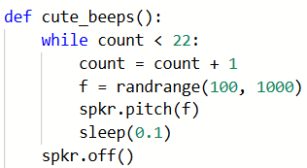
For Loop Practice: Example #3
The SweepLEDs program
You probably identified the cute_beeps() function.
Change the while loop to a for loop.
You can also delete the count = 0 line of code from the main program.
Then run the code to make sure it is error-free.

Slide 11
For Loop Practice: Example #4
The SweepLEDs program – continued
While reviewing the code, you may have also noticed that the main program has some repetition.
Playing the fanfare involves multiple calls to the note() function.
Instead of calling note() four times, can you use a loop?
Well, the arguments in the function calls are not the same. We can’t just call note(F4, 0.4) 4 times.
But what if we create a list!

Slide 12
For Loop Practice: Example #4
The SweepLEDs program – continued
The tricky thing is that there are two arguments for each note, not just one.
So the elements in our list will be tuples.
A tuple is a list that doesn’t change.
It is immutable.
That means it can’t add or delete elements.
This is perfect for the information needed for notes.

Slide 13
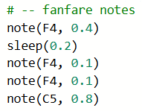
For Loop Practice: Example #4
The SweepLEDs program – continued
Create a list for the notes information.
Use the arguments in notes() as tuples.
A tuple is created using parenthesis ()
There is a rest in the fanfare. We can represent it as a note, using a very low frequency.

Slide 14
For Loop Practice: Example #4
The SweepLEDs program – continued
Define a function for playing the fanfare.
Keep the function name general, in case you want to add other songs to the code.
The song to play will be the parameter.
You are traversing a single list, so use a for loop.

Slide 15
For Loop Practice: Example #4
The SweepLEDs program – continued
Each element in the list is a tuple.
The variable music is an element from the list, so it is a tuple.
We need to access each item in the tuple individually. You access an item in a tuple the same as as a list, using [index]

Slide 16
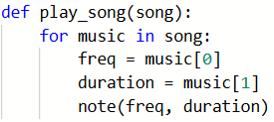
For Loop Practice: Example #4
The SweepLEDs program – continued
Now you can use the individual items as arguments for the notes.

Slide 17
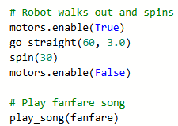
For Loop Practice: Example #4
The SweepLEDs program – continued
In the Main Program, replace all the function calls to note with a single function call to play_song().
The fanfare list is the argument.

Slide 18
For Loop Practice: Example #4
The SweepLEDs program – continued
Cool! You are traversing a list of tuples and using the items to play the notes of a song in order.
You are managing complexity!
The length of the song, or the notes, can change, and you won’t have to modify the function.
You can easily add another song list and play the song using the same play_song() function.

Slide 19
For Loop Practice: Challenge #1
Add another song list to SweepLEDs
Play the song at the beginning of the code.
You can even add a third song to play in between counting guests and starting the runway walk.

Slide 20
For Loop Practice: Challenge #2
Review the remix projects you completed.
Select one of them and modify it to use a list and for loop.

Slide 21
Wrap Up
Submit the modified programs to your teacher.
Complete the wrap-up questions in the assignment.

